Slide 1
Movie script Text Analysis
20186663 전찬웅

Slide 2
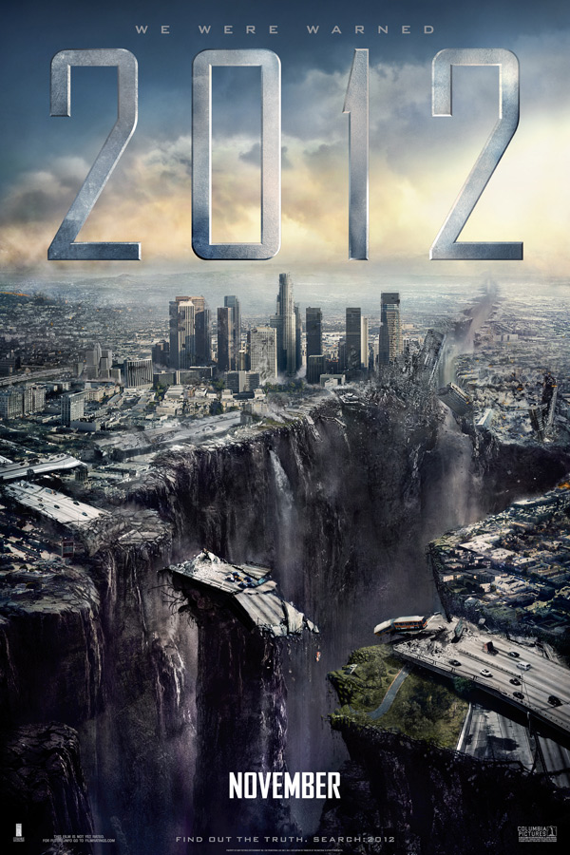
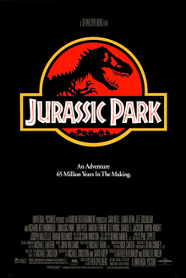
What kind of movies?
Title : 2012
( Roland Emmerich)
Title : Jurassic Park
(Steven Allan Spielberg)

Slide 3
Hypothesis
I think that depending on director, story and background (and so on)…,movie “2012” has specific name of Natural Disasters(like earthquake..), but movie “Jurassic Park” has another kind of specific name like dinosaur(T-rex…)
So the words in “2012" movies are different from those in “Jurassic Park".

Slide 4
Text analysis
I use Python in Jupyter notebook.

Slide 5
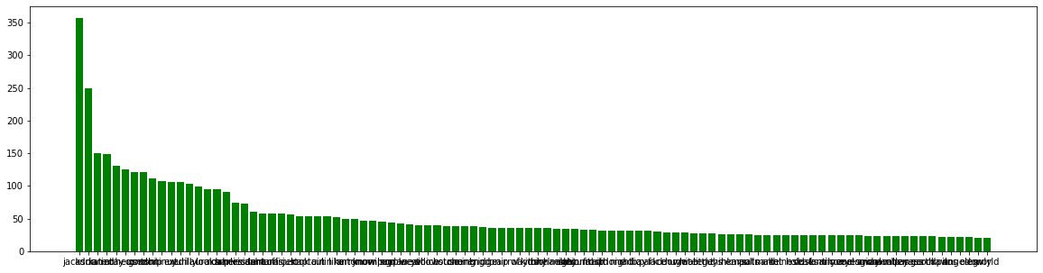
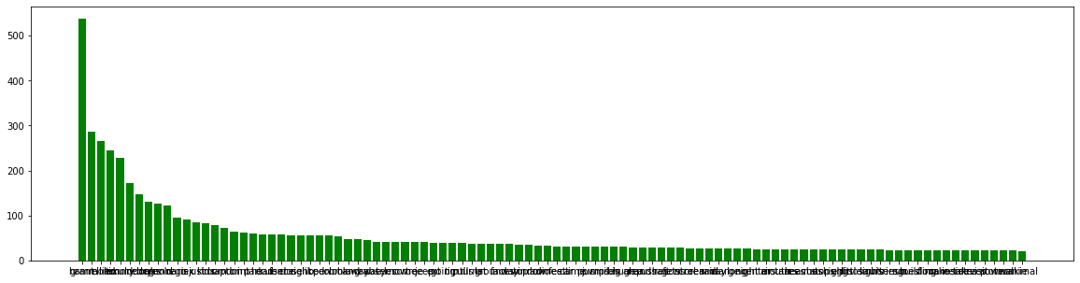
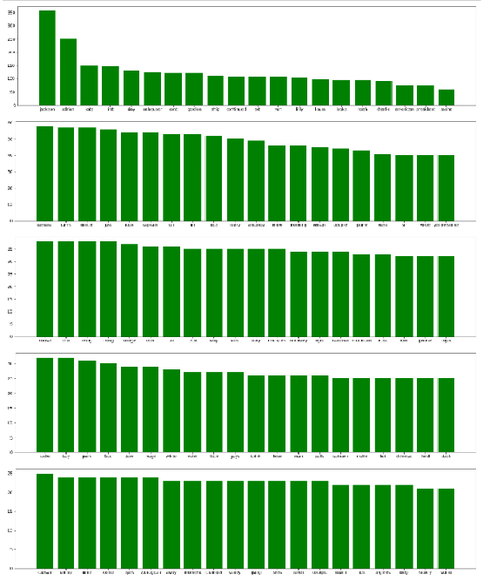
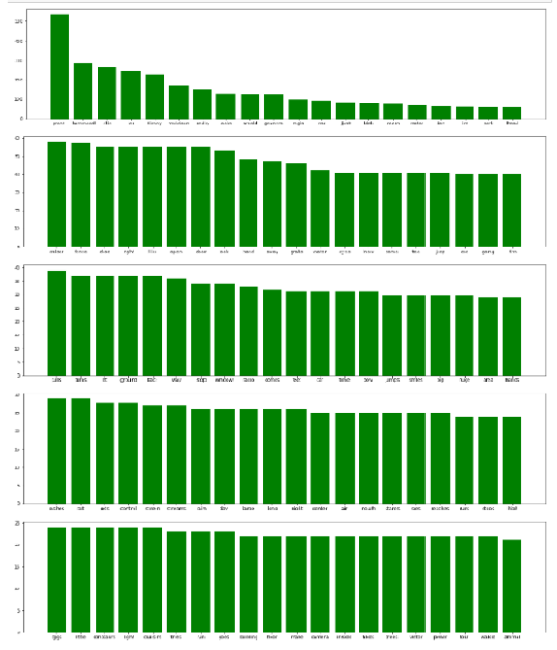
Word distribution Graph
2012
Jurassic Park
top100
top100
Top1~20
Top21~40
Top41~60
Top61~80
Top81~100
Top1~20
Top21~40
Top41~60
Top61~80
Top81~100

Slide 6
conclusion
Not many, but in the movie Jurassic Park, there were some words like dinosaurs, lapter and so on.
And in the movie 2012, We can find some word Yellowstone, china, mountain, frost and so on
But movie script has character name, and then the character's name came out frequently, so they disturb analysis.

Slide 7
thanks

